Slide 1


Variational Monte Carlo method
Ilaria Carpi

Slide 2


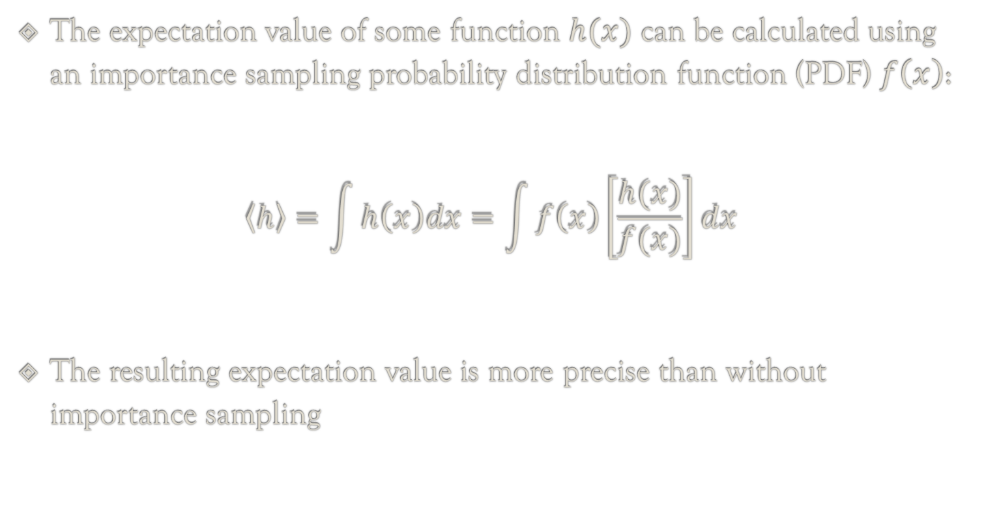
Importance Sampling
The expectation value of some function $h(x)$ can be calculated using an importance sampling probability distribution function (PDF) $f\left(x\right)$:
$$\left.\left\langle h\right\rangle =\int{h\left(x\right)dx}=\int{f\left(x\right)\left[\frac{h(x)}{f(x)}\right]dx}\right.$$
The resulting expectation value is more precise than without importance sampling

Slide 3
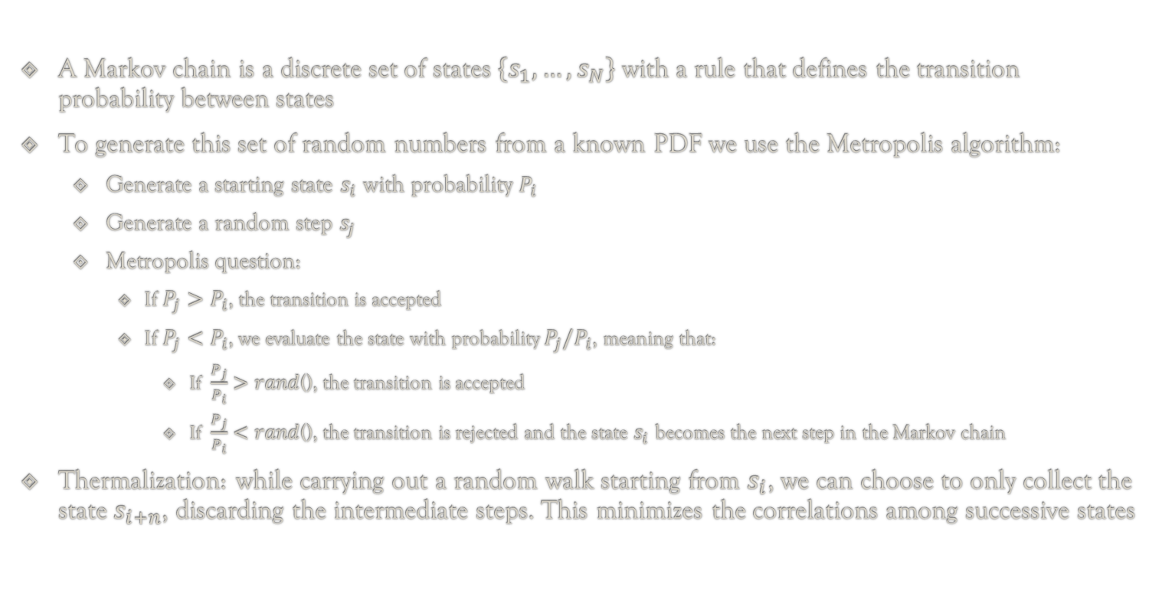
Markov Chains and Metropolis Algorithm
A Markov chain is a discrete set of states $\left\{s_{1}, …, s_{N}\right\}$ with a rule that defines the transition probability between states
To generate this set of random numbers from a known PDF we use the Metropolis algorithm:
Generate a starting state $s_{i}$ with probability $P_{i}$
Generate a random step $s_{j}$
Metropolis question:
If $P_{j}>P_{i}$, the transition is accepted
If $P_{j}<P_{i}$, we evaluate the state with probability $P_{j}/P_{i}$, meaning that:
If $\frac{P_{j}}{P_{i}}>rand$(), the transition is accepted
If $\frac{P_{j}}{P_{i}}<rand$(), the transition is rejected and the state $s_{i}$ becomes the next step in the Markov chain
Thermalization: while carrying out a random walk starting from $s_{i}$, we can choose to only collect the state $s_{i+n}$, discarding the intermediate steps. This minimizes the correlations among successive states

Slide 4
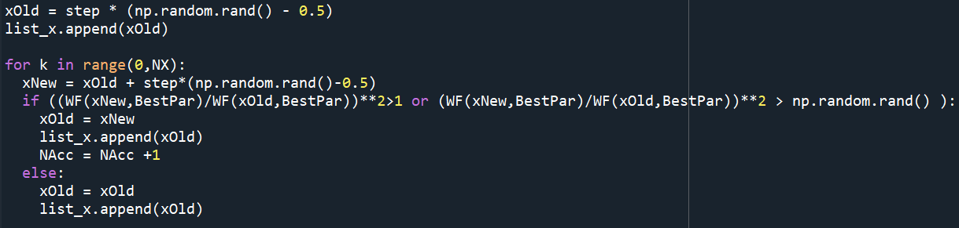
Markov Chains and Metropolis Algorithm
An example of Metropolis algorithm to generate a random set of coordinates. The probability is given by the 1D harmonic oscillator wave function

Slide 5
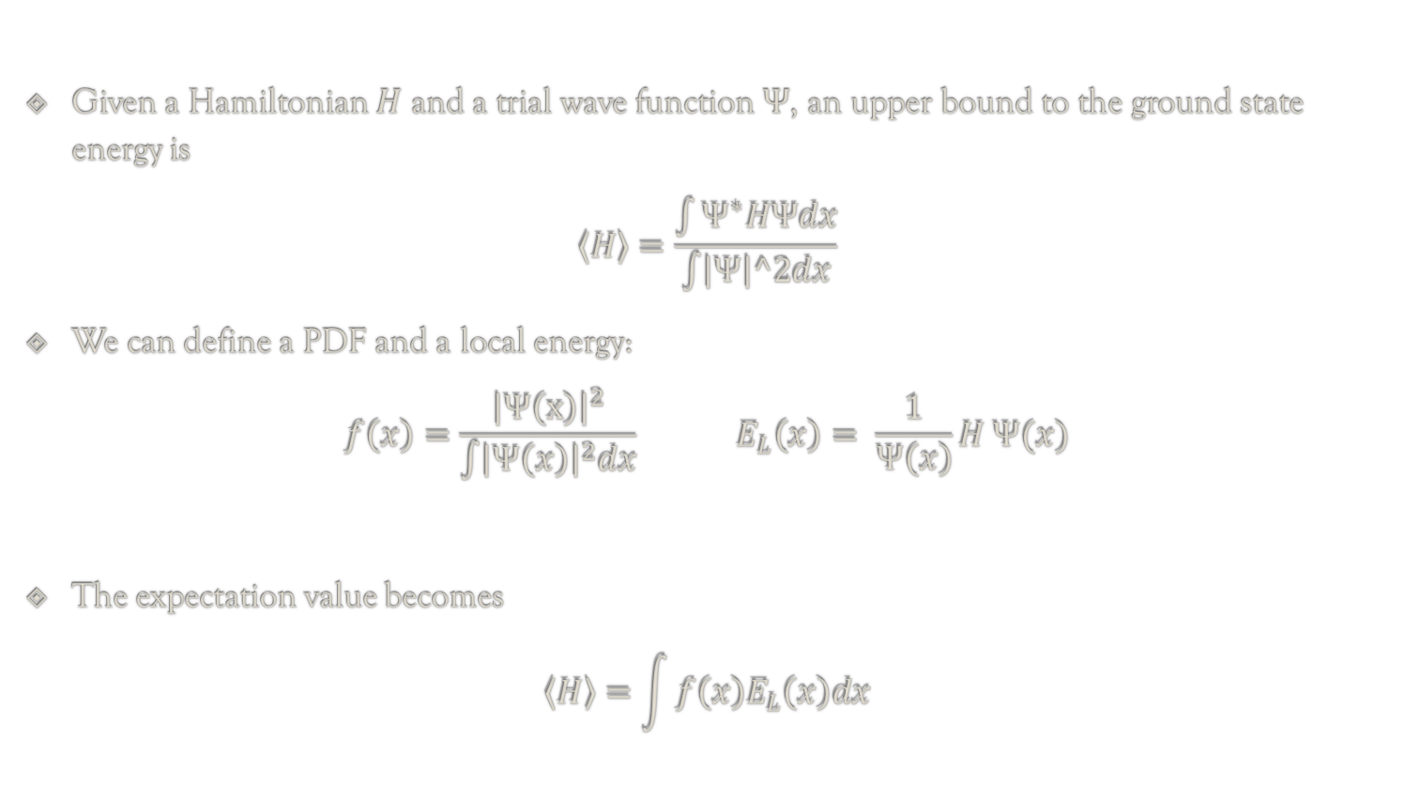
Variational Principle
Given a Hamiltonian $H$ and a trial wave function $Ψ$, an upper bound to the ground state energy is
$$\left\langle H\right\rangle =\frac{\int{Ψ^{∗}HΨdx}}{\int{\left|Ψ\right|^2dx}}$$
We can define a PDF and a local energy:
$$f\left(x\right)=\frac{{\left|Ψ\left(x\right)\right|}^{2}}{\int{{\left|Ψ\left(x\right)\right|}^{2}dx}} E_{L}\left(x\right)= \frac{1}{Ψ\left(x\right)}H Ψ(x)$$
The expectation value becomes
$$\left\langle H\right\rangle =\int{f\left(x\right)E_{L}\left(x\right)dx}$$

Slide 6
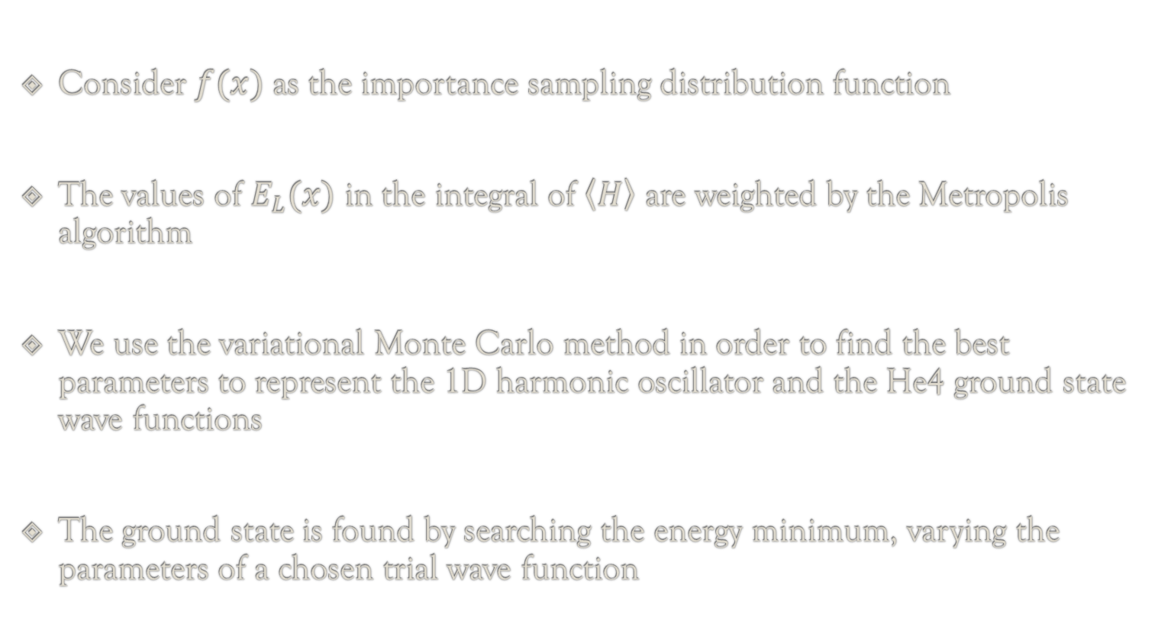
Variational Monte Carlo
Consider $f(x)$ as the importance sampling distribution function
The values of $E_{L}(x)$ in the integral of $\left\langle H\right\rangle$ are weighted by the Metropolis algorithm
We use the variational Monte Carlo method in order to find the best parameters to represent the 1D harmonic oscillator and the He4 ground state wave functions
The ground state is found by searching the energy minimum, varying the parameters of a chosen trial wave function

Slide 7
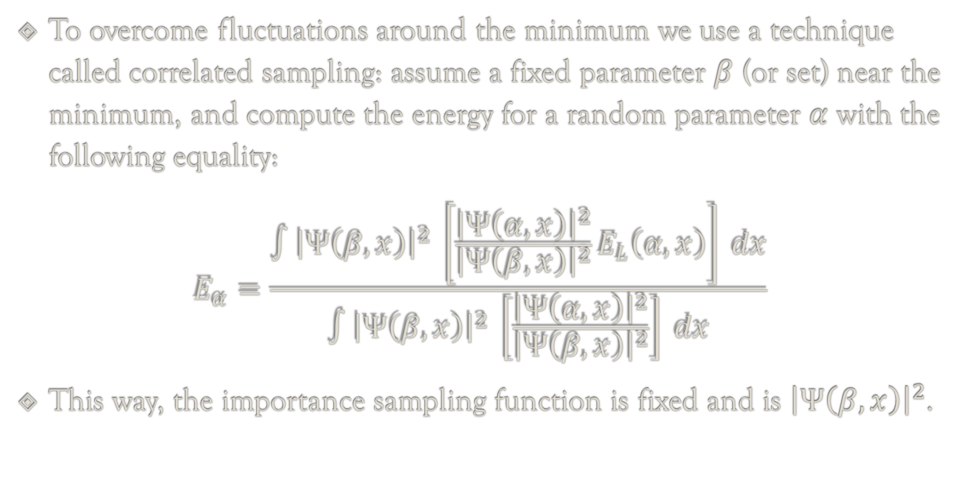
Variational Monte Carlo
To overcome fluctuations around the minimum we use a technique called correlated sampling: assume a fixed parameter $β$ (or set) near the minimum, and compute the energy for a random parameter $α$ with the following equality:
$$E_{α}=\frac{∫{\left|Ψ\left(β,x\right)\right|}^{2} \left[\frac{{\left|Ψ\left(α,x\right)\right|}^{2}}{{\left|Ψ\left(β,x\right)\right|}^{2}}E_{L}\left(α, x\right)\right] dx}{∫{\left|Ψ\left(β,x\right)\right|}^{2} \left[\frac{{\left|Ψ\left(α,x\right)\right|}^{2}}{{\left|Ψ\left(β,x\right)\right|}^{2}}\right] dx}$$
This way, the importance sampling function is fixed and is ${\left|Ψ\left(β,x\right)\right|}^{2}$.

Slide 8
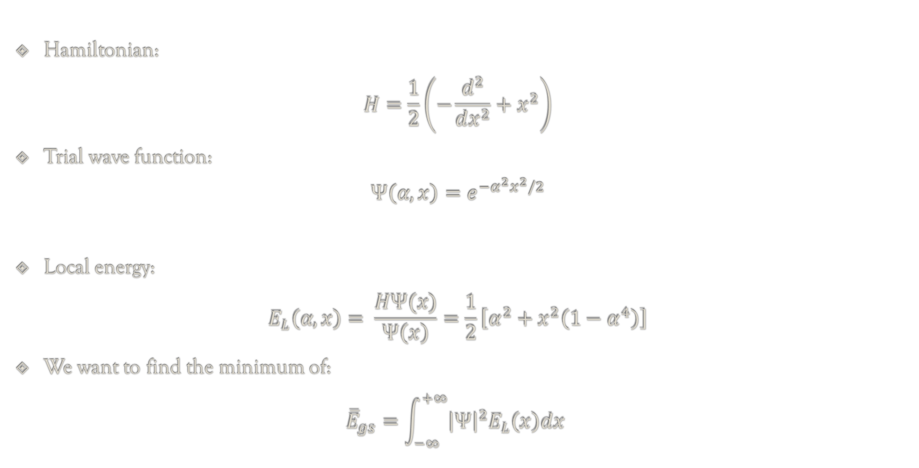
1D Harmonic Oscillator
Hamiltonian:
$$H=\frac{1}{2}\left(−\frac{d^{2}}{dx^{2}}+x^{2}\right)$$
Trial wave function:
$$Ψ\left(α,x\right)=e^{−α^{2}x^{2}/2}$$
Local energy:
$$E_{L}\left(α,x\right)= \frac{HΨ(x)}{Ψ\left(x\right)}=\frac{1}{2}\left[α^{2}+x^{2}\left(1−α^{4}\right)\right]$$
We want to find the minimum of:
$${\overline{E}}_{gs}=\int_{−∞}^{+∞}{{\left|Ψ\right|}^{2}E_{L}\left(x\right)dx }$$

Slide 9
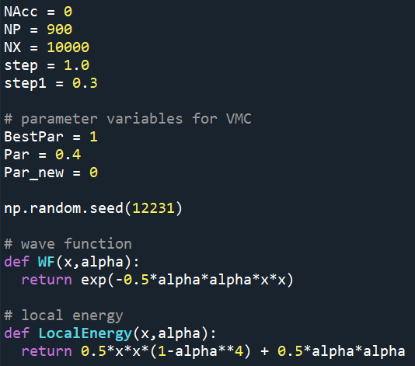
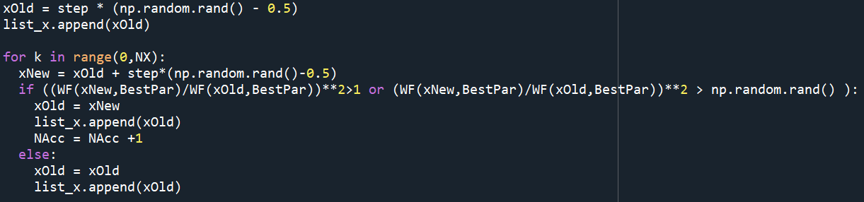
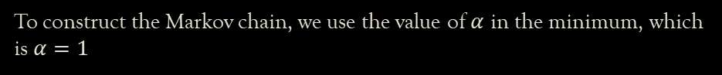
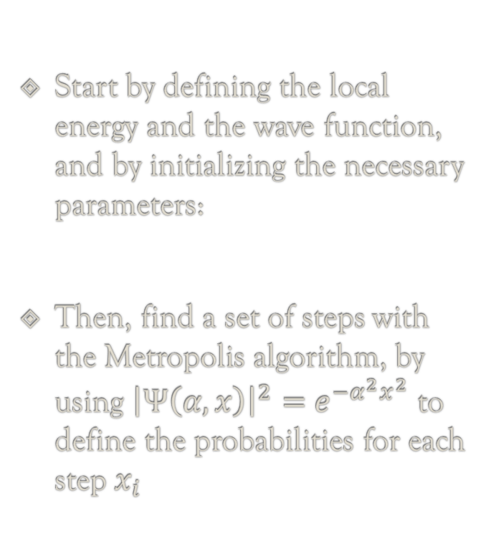
1D Harmonic Oscillator
Start by defining the local energy and the wave function, and by initializing the necessary parameters:
Then, find a set of steps with the Metropolis algorithm, by using ${\left|Ψ\left(α,x\right)\right|}^{2}=$ $e^{−α^{2}x^{2}}$ to define the probabilities for each step $x_{i}$
To construct the Markov chain, we use the value of $α$ in the minimum, which is $α=1$

Slide 10
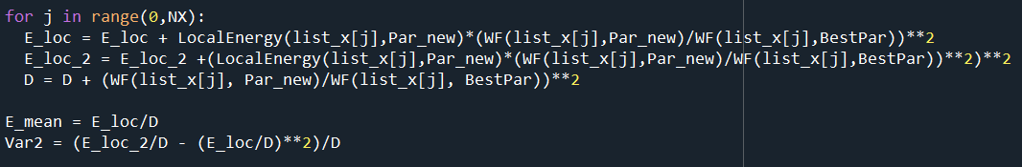
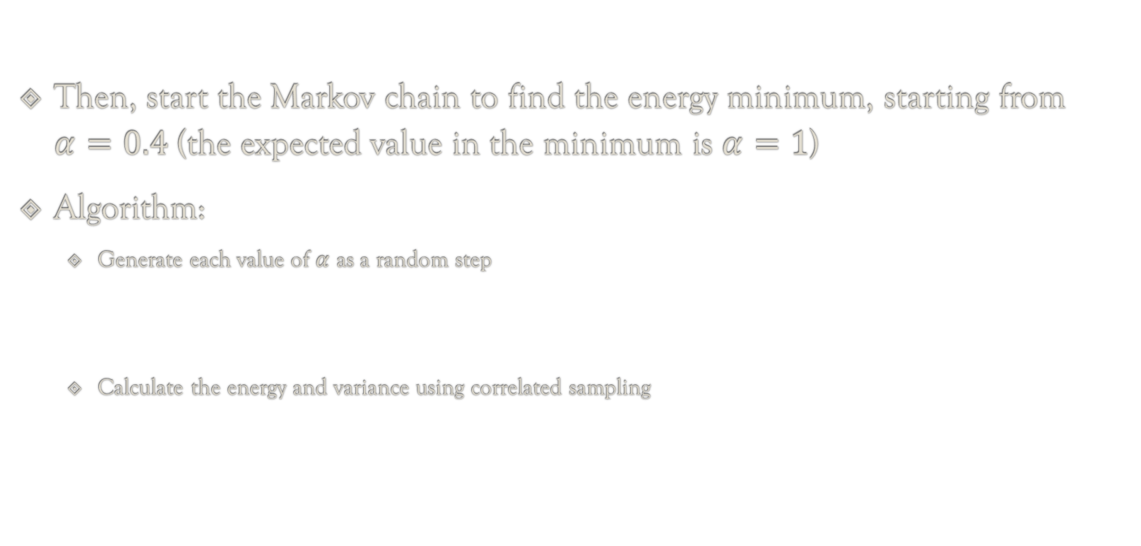
1D Harmonic Oscillator
Then, start the Markov chain to find the energy minimum, starting from $α=0.4$ (the expected value in the minimum is $α=1$)
Algorithm:
Generate each value of $α$ as a random step
Calculate the energy and variance using correlated sampling

Slide 11
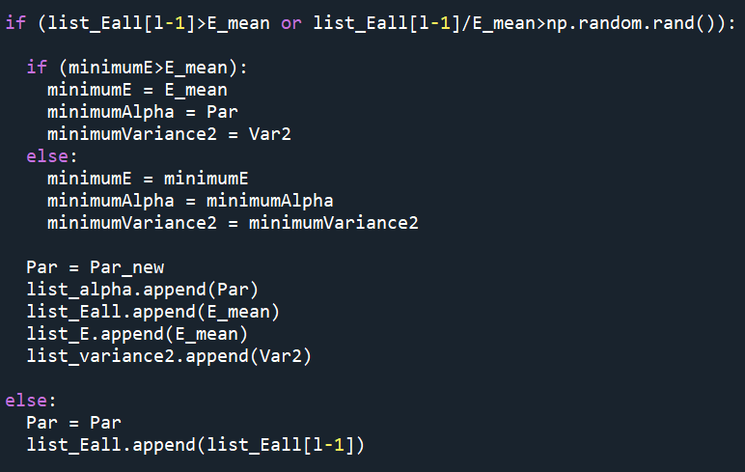
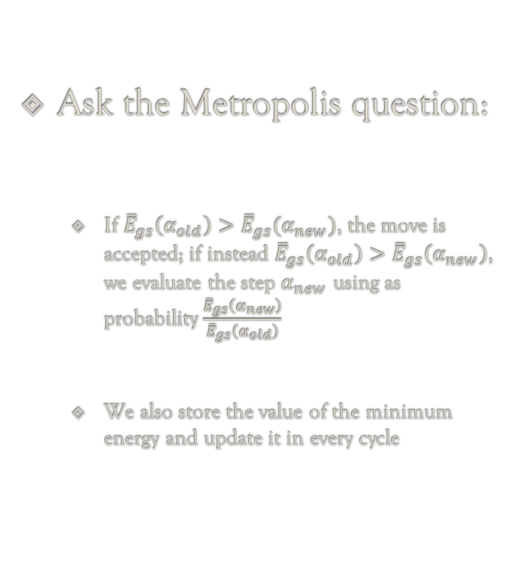
1D Harmonic Oscillator
Ask the Metropolis question:
If ${\overline{E}}_{gs}\left(α_{old}\right)>{\overline{E}}_{gs}(α_{new})$, the move is accepted; if instead ${\overline{E}}_{gs}\left(α_{old}\right)>{\overline{E}}_{gs}\left(α_{new}\right)$, we evaluate the step $α_{new}$ using as probability $\frac{{\overline{E}}_{gs}\left(α_{new}\right)}{{\overline{E}}_{gs}\left(α_{old}\right)}$
We also store the value of the minimum energy and update it in every cycle

Slide 12
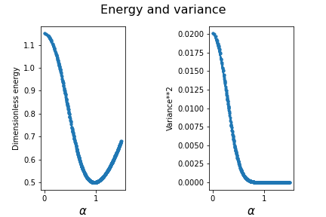
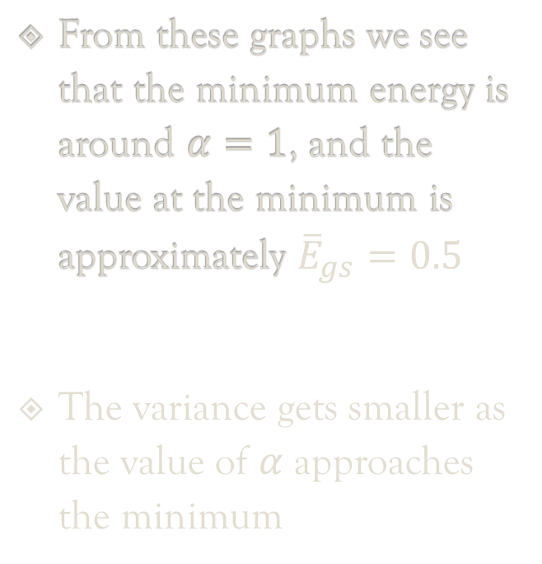
1D Harmonic Oscillator: results
From these graphs we see that the minimum energy is around $α=1$, and the value at the minimum is approximately ${\overline{E}}_{gs}=0.5$
The variance gets smaller as the value of $α$ approaches the minimum

Slide 13
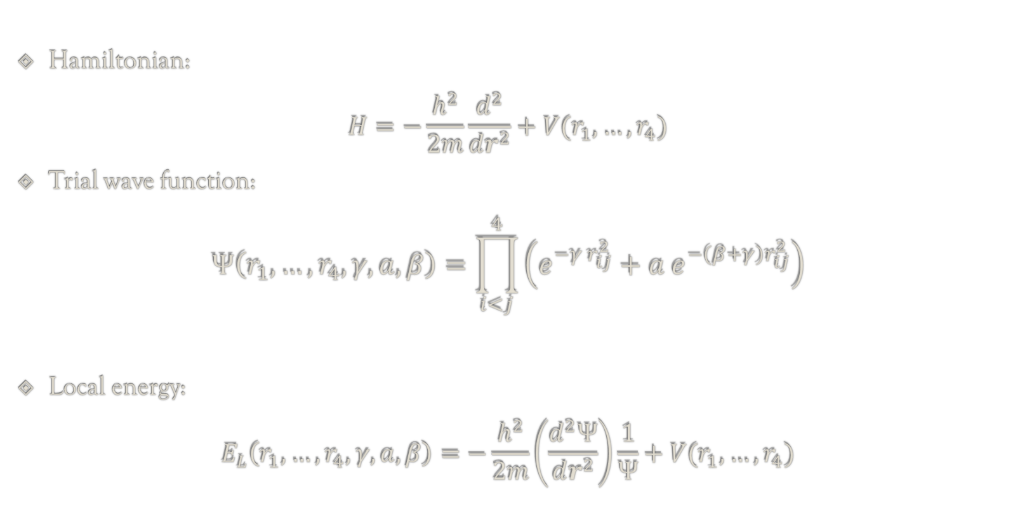
Ground State of Helium – 4
Hamiltonian:
$$H=−\frac{h^{2}}{2m}\frac{d^{2}}{dr^{2}}+V(r_{1},…,r_{4})$$
Trial wave function:
$$Ψ\left(r_{1},…,r_{4}, γ, a, β\right)=\prod_{i<j}^{4}{\left(e^{−γ r_{ij}^{2}}+a e^{−\left(β+γ\right)r_{ij}^{2}}\right)}$$
Local energy:
$$E_{L}\left(r_{1},…,r_{4}, γ, a, β\right)=−\frac{h^{2}}{2m}\left(\frac{d^{2}Ψ}{dr^{2}}\right)\frac{1}{Ψ}+V(r_{1},…,r_{4})$$

Slide 14
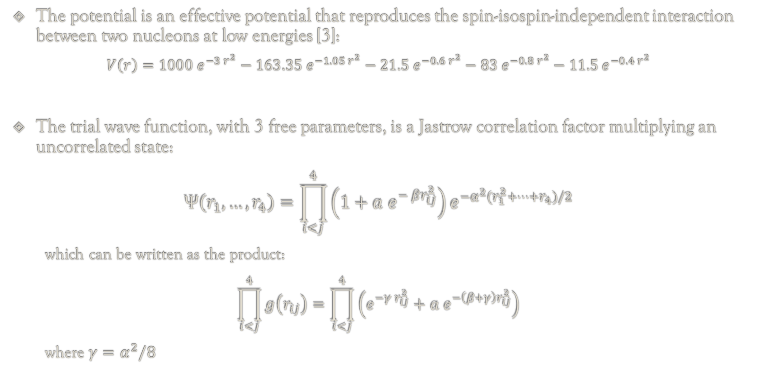
Ground State of Helium – 4
The potential is an effective potential that reproduces the spin-isospin-independent interaction between two nucleons at low energies [3]:
$$V\left(r\right)=1000 e^{−3 r^{2}}−163.35 e^{−1.05 r^{2}}−21.5 e^{−0.6 r^{2}}−83 e^{−0.8 r^{2}}−11.5 e^{−0.4 r^{2}}$$
The trial wave function, with 3 free parameters, is a Jastrow correlation factor multiplying an uncorrelated state:
$$Ψ\left(r_{1},…,r_{4}\right)=\prod_{i<j}^{4}{\left(1+a e^{− βr_{ij}^{2}}\right)e^{−α^{2}(r_{1}^{2}+…+r_{4})/2}}$$
which can be written as the product:
$$\prod_{i<j}^{4}{g\left(r_{ij}\right)}=\prod_{i<j}^{4}{\left(e^{−γ r_{ij}^{2}}+a e^{−\left(β+γ\right)r_{ij}^{2}}\right)}$$
where $γ=α^{2}/8$

Slide 15
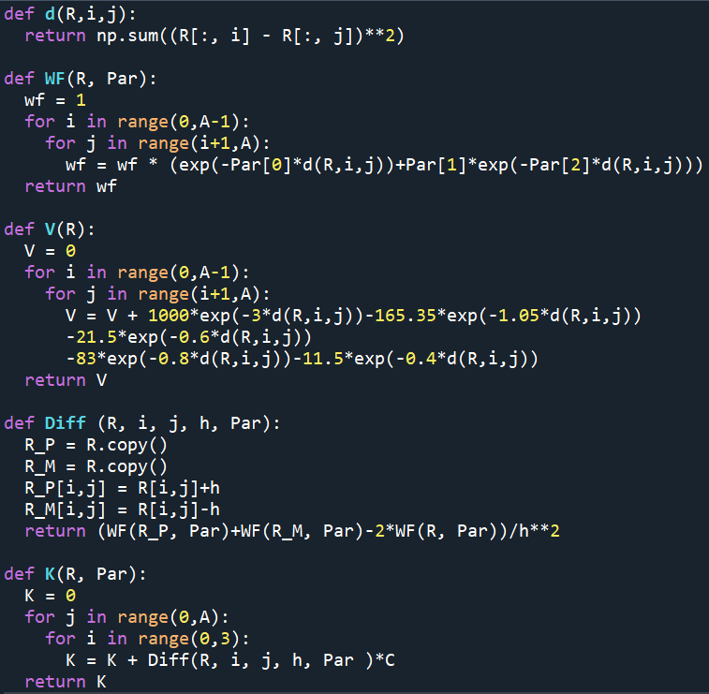
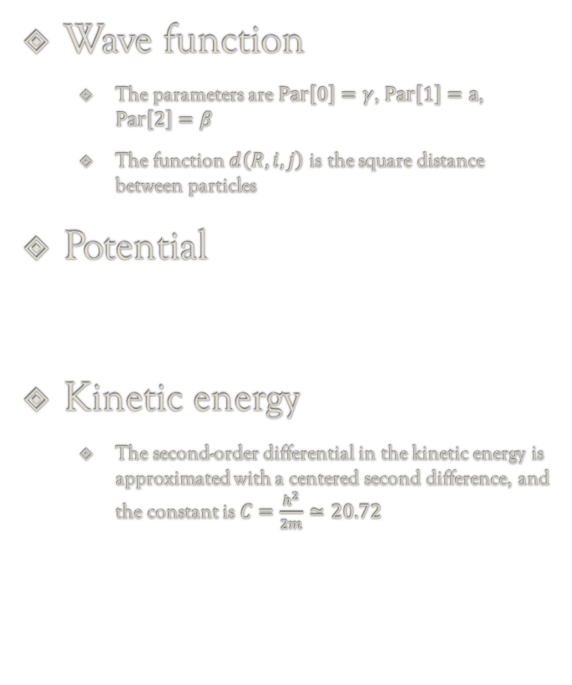
Ground State of Helium – 4
Wave function
The parameters are $Par\left[0\right]=γ$, $Par\left[1\right]=a$, $Par\left[2\right]=β$
The function $d\left(R,i,j\right)$ is the square distance between particles
Potential
Kinetic energy
The second-order differential in the kinetic energy is approximated with a centered second difference, and the constant is $C=\frac{h^{2}}{2m}≃20.72$

Slide 16
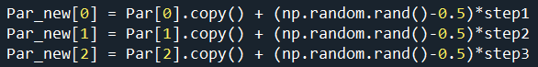
Ground State of Helium – 4
As the final goal for parameters, we take the values from ref. [1]
The code structure is the same as in the 1d harmonic oscillator case, with the difference that now we are varying 3 parameters:

Slide 17
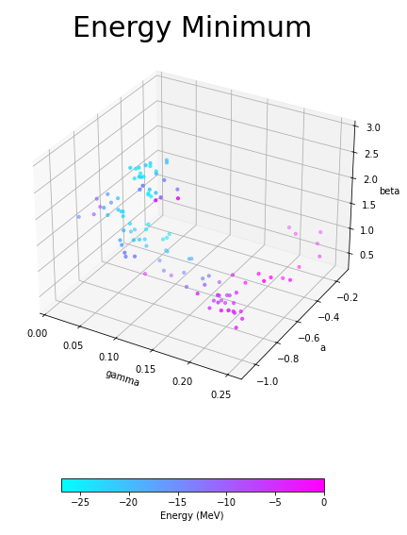
Ground State of Helium – 4: results
Varying the parameter steps and the number of iterations of the VMC cycle, the results are visibly different
The starting parameters that optimize the precision and the running time are:
step1 = 10/100
step2 = 25/100
Step3 = 50/100

Slide 18
References
R. Guardiola, "Monte Carlo Methods in Quantum Many Body Theories", 1998, DOI: 10.1007/BFb0104529
R. F. Bishop, E. Buendia, M. F. Flynn and R. Guardiola, "Diffusion Monte Carlo Determination of the Binding Energy of the 4He Nucleus for Model Wigner Potentials", 1992, DOI: 10.1088/0954-3899/18/2/002
I. R. Afnan, Y. C. Tang, "Investigation of Nuclear Three- and Four-Body Systems with Soft-Core Nucleon-Nucleon Potentials", 1968, DOI: 10.1103/PhysRev.175.1337
A. Gezerlis, "Numerical Methods in Physics with Python", ch. 7, 2020, DOI: 10.1017/9781108772310

